Slide 1
Agile Software Development
Dr. Nasser Mustafa

Slide 2
Today’s Lecture: Agile Development Method
Objectives
Understand the requirements Validation Activity
Understand the rationale for agile software development methods, the agile manifesto, and the differences between agile and plan-driven development;
Know the key practices in extreme programming and how these relate to the general principles of agile methods;
Understand the Scrum approach to agile project management;
Be aware of the issues and problems of scaling agile development methods to the development of large software systems.

Slide 3
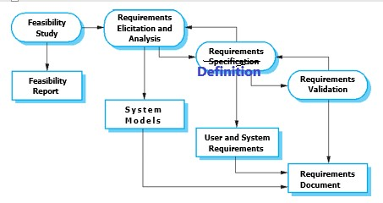
Requirement Engineering Activities
1
2
3
4

Slide 4
Validation and Verification
Validation is checking that requirements define the system the customer wants (doing the right system).
Verification is checking that the software meets specifications(doing the system right).

Slide 5
Requirements Validation- Types of Checking
Validity checks: Checking for additional or different functions that are required.
Consistency checks: Requirements should not conflict, there should not be contradictory descriptions of the same system function.
Completeness checks: SRS should include requirements that define all functions and the constraints intended by the system user.
Realism checks: ensuring that the requirements can actually be implemented ( consider budget and schedule )
Verifiability: Requirements should always be written so that they are verifiable. Write a set of tests that can demonstrate that the delivered system meets each specified requirement.

Slide 6
Software Development Models
Looking Back……..
Waterfall Model
V Model
Spiral Model
Incremental Model
In all models activities are planned in advance and progress is measured against this plan.

Slide 7
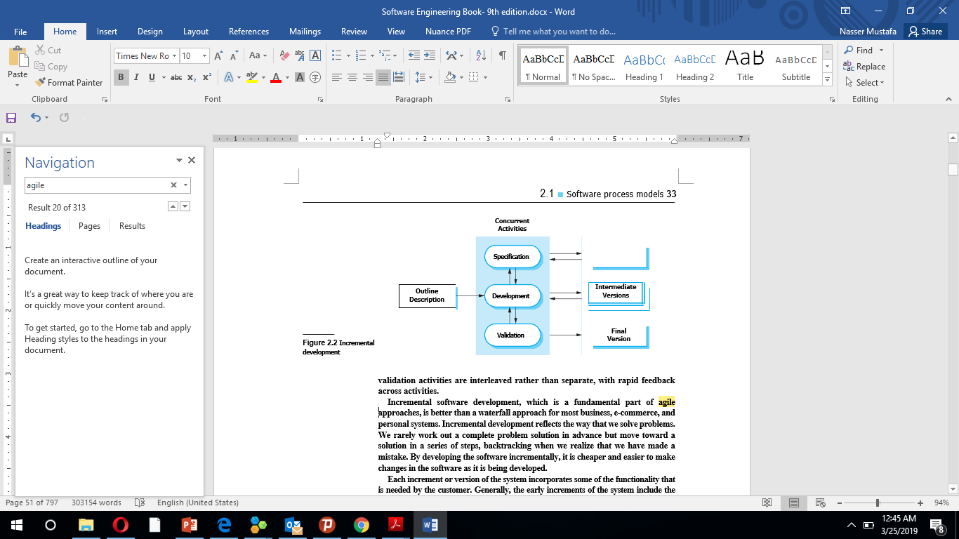
Incremental Model
Better than a waterfall approach for most business, e-commerce, and personal systems
The most common approach for the development of application systems.
Can be either plan-driven, agile, or, a mixture of these approaches

Slide 8
Agile Development Method
The notion of Agile was Introduced in the late 1990s.
Requirements are developed incrementally according to user priorities
Elicitation of requirements comes from users who are part of the development team
Many forms of agile development
Dynamic Software Development Method (DSDM), (Stapleton, 1997)
Scrum (Schwaber and Beedle, 2001)
Extreme Programming (XP) (Beck, 1999; Beck, 2000)

Slide 9
Motivation
Businesses operate in a global, rapidly changing environment
Requirements are changing as a result of changing environment
It is not easy to predict all requirements in advances
Respond to new opportunities and market changes

Slide 10
Characteristics
The processes of specification, design, and implementation are interleaved.
There is no detailed system specification, and design documentation is mini­mized
Developers are not well experienced in one aspect but have some experience in all development aspects( analysis, desgin, coding, testing)
The user requirements document only defines the most important characteristics of the system.
The system is developed in a series of versions.
End-users and other system stakeholders are involved in specifying and evaluating each version.
System user interfaces are developed using an interactive development system that allows the interface design to be quickly

Slide 11
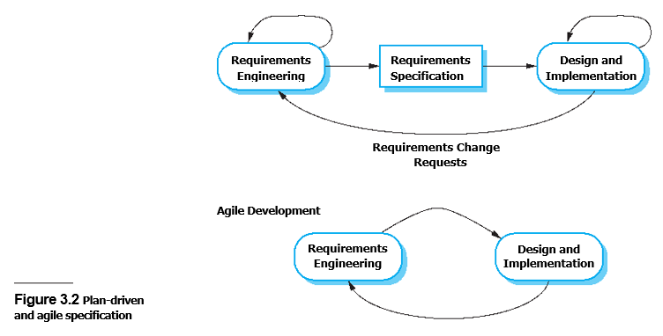
Agile Vs Plan Driven (Traditional) Development

Slide 12
How to decide? Agile or Plan Driven (Traditional) Development
System require detailed specification and design
Require to deliver the software to customers and get rapid feedback
Size of the system being delivered – Small teams imply agile
Type of the system (need lot of analysis…. Go for traditional)
Lifetime of the system (long life time….Go for traditional)
How good are the designers and programmers in the development team ( good people for design, low skill people for programming)
Is the system subject to external regulation?

Slide 13
Agile Methods
Extreme Programming
Takes an ‘extreme’ approach to incremental development. New versions of the software may be built several times per day and releases are delivered to customers roughly every two weeks
Requirements are expressed as scenarios (called user stories)
user stories are implemented directly as a series of tasks. Programmers work in pairs and develop tests for each task before writing the code.
All tests must be suc­cessfully executed when new code is integrated into the system
User involvement in testing and validation
There is a short time gap between releases of the system.
customers are intimately involved in specifying and prioritizing system requirements

Slide 14
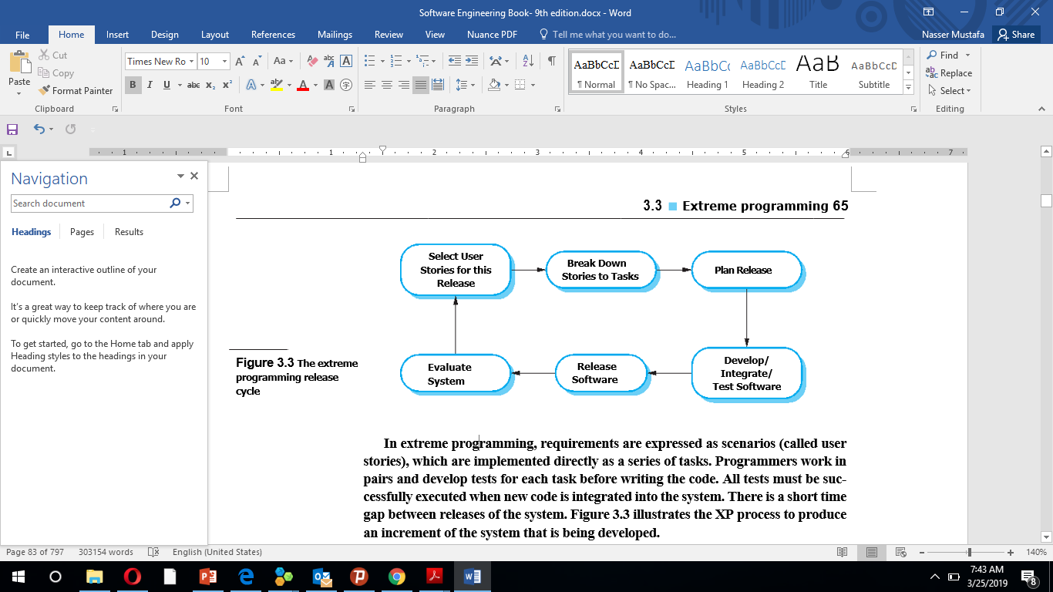
Agile Methods-Extreme Programming

Slide 15
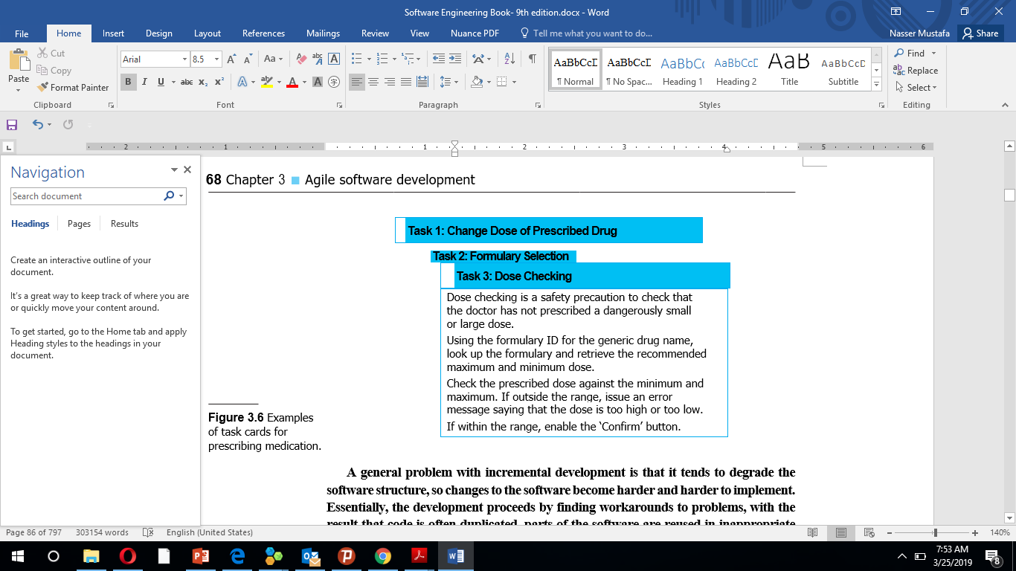
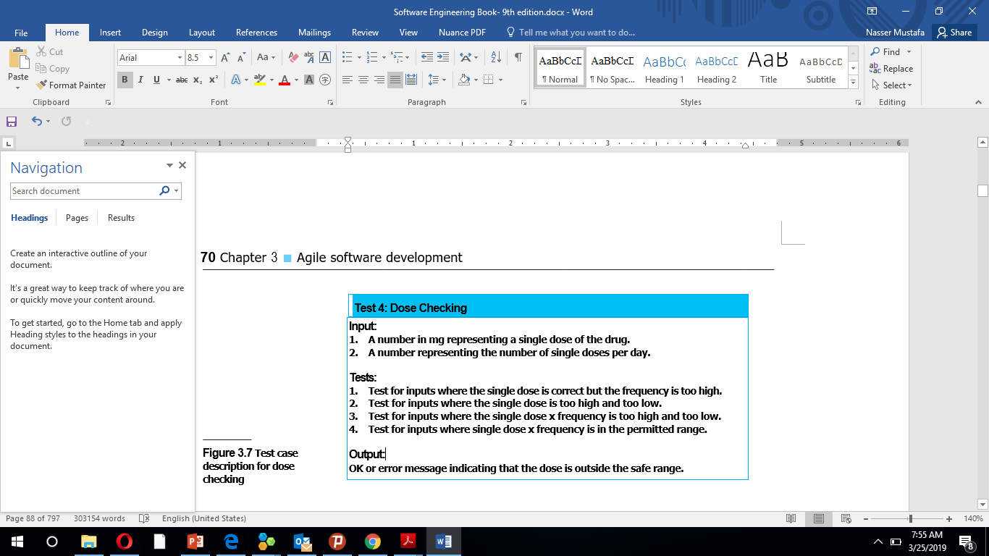
Agile Methods-Extreme Programming

Slide 16
Agile Methods
Pair Programming
A practice that has been introduced in XP
Programmers work in pairs to develop the software.
Programmers sit together at the same worksta­tion to develop the software.
The same pairs do not always program together. Rather, pairs are created dynamically so that all team members work with each other

Slide 17
Agile Methods
Pair Programming
It supports the idea of collective ownership and responsibility for the system.
It acts as an informal review process, each line of code is looked at by at least two people.
Inspection process much cheaper than formal program inspections.
It helps support refactoring, which is a process of software improvement.

Slide 18
Agile Methods
Scrum
Agile method focuses on managing iterative development
It does not prescribe the use of programming practices such as pair
There are three phases
planning phase where you establish the general objectives for the project and design the software architecture.
followed by a series of sprint cycles, where each cycle develops an increment of the system.
Project closure phase wraps up the project and completes documentation user manuals, and assesses the lessons learned from the project.

Slide 19
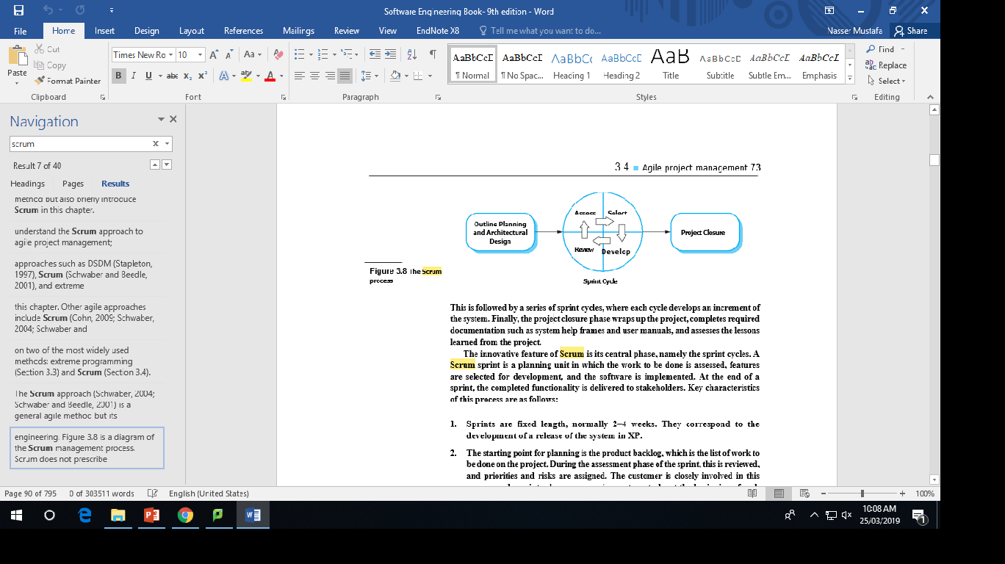
Agile Methods
Scrum

Slide 20
Video Link- Agile development
https://www.youtube.com/watch?v=q8X2Rk5sRFI

